Slide 1
Lecture 7 Beyond Linear Programming
Professor Dong, Washington University in St. Louis, MO

Slide 2
Agenda
Problems beyond linear programming
Definition of nonlinear programming (NLP) problems
An example: location problem
Solution procedure
Local vs. global optimal solutions
Using Solver
Convex/concave programming problems
Quadratic programming
Examples
Summary
Professor Dong, Washington University in St. Louis, MO

Slide 3
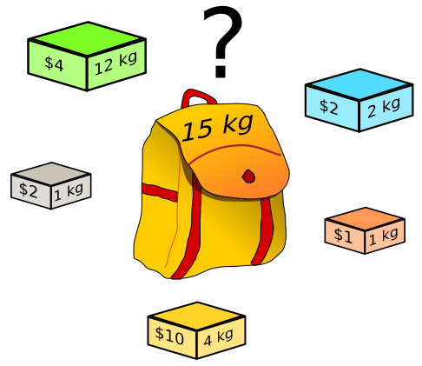
Knapsack Problem
Professor Dong, Washington University in St. Louis, MO

Slide 4
Location Problem
y
The Rappaport Communications Company provides cellular telephone services in several mid-western states. The company is planning to expand its customer base by offering cellular service in northeastern Ohio to the cities of Cleveland, Akron, Canton, and Youngstown. The company will install the hardware necessary to service customers in each city on pre-existing communications towers in each city. The locations of these towers are summarized in the figure.
However, the company also needs to construct a new communications tower somewhere between these cities to handle inter-city calls. This tower will also allow cellular calls to be routed onto the satellite system for world-wide calling service. The tower the company is planning to build can cover areas within a 40-mile radius. Thus, the tower needs to be located within 40 miles of each of these cities.
Cleveland
(5,45)
Akron
(12,21)
Youngstown
(52,21)
(?, ?)
Canton
(17,5)
x
Suppose to achieve the best overall service
quality we need to minimize the total distance
from the tower to each of the four cities.
From Geometry: the Euclidean distance
between (x₁,y₁) and (x₂,y₂) can be calculated
by
Professor Dong, Washington University in St. Louis, MO

Slide 5
Location Problem Formulation
Decision Variables
Objective function
Constraints
Professor Dong, Washington University in St. Louis, MO

Slide 6
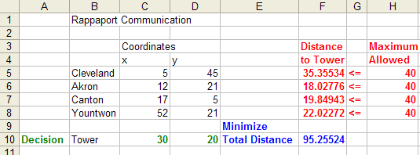
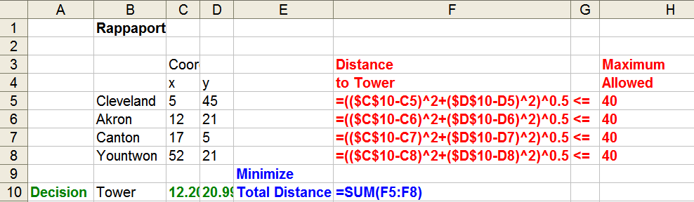
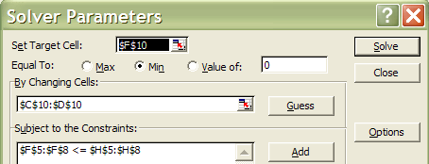
Excel Setup

Slide 7
Definition of Nonlinear Programming (NLP) Problem
MAX (MIN) F(x₁,x₂,…,x_{n}) F is nonlinear
Subject to and / or
G₁(x1,x2,…,x_{n})= B₁ one or more of G_{i} or H_{i}
G₂(x1,x2,…,x_{n})= B₂ possess nonlinear terms
.
.
.
G_{m}(x1,x2,…,x_{n})=B_{m}
H₁(x1,x2,…,x_{n})≤(≥) R₁
H₂(x1,x2,…,x_{n})≤(≥) R₂
.
.
.
H_{k}(x1,x2,…,x_{n})≤(≥)R_{k}
Nonlinear term: any term other than one of the form ax, where a is a
constant and x is a variable raised to the first power.
Professor Dong, Washington University in St. Louis, MO

Slide 8
Nature of NLP Problems
Nonlinear objective function:
Linear objective function:
Linear constraints:
Nonlinear constraints:
Professor Dong, Washington University in St. Louis, MO

Slide 9
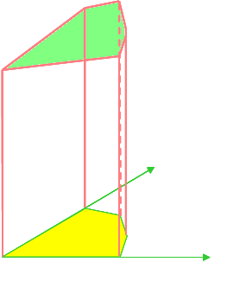
Nature of NLP Problems
Nonlinear OBJ & Nonlinear Constraints:
Linear OBJ & Linear Constraints:
Optimal solution may occur in the interior of the feasible region
Optimal solution always occurs at the boundary of the feasible region

Slide 10
Solution Strategies for NLP Problems
Solver uses generalized reduced gradient (GRG) algorithm (hill-climbing tactics) to solve NLP problems
Begins at a feasible solution (starting point)
Select direction in the feasible region that causes the objective function to improve
Make some amount of movement (step size) in the selected direction
Reach a new, and better, feasible solution
Stops until there is no feasible direction in which to move that results in an improvement in the objective function.

Slide 11
Local vs. Global Optimal Solutions
Local optimal solution:
a solution that is better than any other feasible solution in its immediate, or local, vicinity
Global optimal solution:
Global optimal
Global maximum
Local maximum
Global minimum
Local minimum
Professor Dong, Washington University in St. Louis, MO

Slide 12
Avoid Discontinuous Functions
A number of functions should be avoided when using the nonlinear solver
Logical functions such as IF() or AND()
Mathematical functions such as ROUND() or CEILING()
Lookup and reference functions such as CHOOSE() or VLOOKUP()
Statistical functions such as RANK() or COUNT()
In general, any function that changes discontinuously is to be avoided
The problem these functions create for the hill-climbing algorithm in Solver is that they can turn a smooth hill into one with abrupt cliffs. Since the hill-climbing procedure cannot “see” beyond its immediate surroundings, when it comes to a cliff, it simply stops.
Professor Dong, Washington University in St. Louis, MO

Slide 13
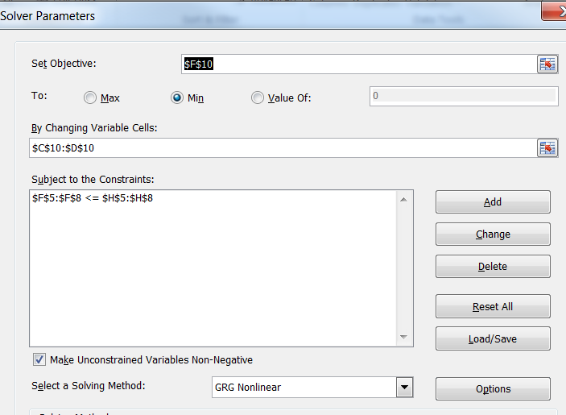
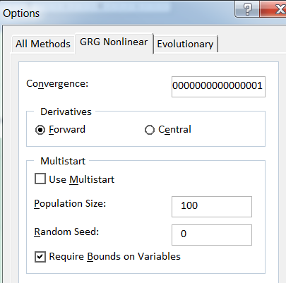
Using Solver
Solver stops if the relative change in OBJ value for several iterations is smaller than the convergence factor
Derivatives: determines how Solver estimates derivatives
Forward: one direction
Central: two directions

Slide 14
A Note About “Optimal” Solutions
Solver Message | Interpretation | What to do
“Solver found a solution. All constraints and optimality conditions are satisfied.” | Found a local optimal solution, but does not guarantee it is global optimal | Unless you are sure it is global optimal, you should run solver from several different starting points to increase the chances of finding the global optimal.
“Solver has converged to the current solution. All constraints are satisfied.” | OBJ value changed very slowly for the last few iterations. | Reduce the “Convergence “ option in Solver Options dialog box to avoid convergence at suboptimal solution.
“Solver cannot improve the current solution. All constraints are satisfied.” | This is a rare message. Model is degenerate and Solver is cycling. | Try to eliminate redundant constraints.
Professor Dong, Washington University in St. Louis, MO

Slide 15
Sensitivity Analysis in NLP
In NLP
Lagrange Multiplier:
similar interpretation as the shadow price in LP but we cannot determine the allowable range of RHS values over which Lagrange multiplier will remain valid. Lagrange multipliers can be used only to estimate the approximate impact on the OBJ function of changing a constraint’s RHS constant by small amount
Reduced Gradient of a variable: similar interpretation as the reduced cost in LP
In LP
Shadow Price:
the amount by which the OBJ value would change if the RHS constant of constraint is increased by one unit [can be used if changes of RHS constant are within the allowable range].
Reduced Cost of a variable: represents the amount by which the OBJ function would reduce if this variable were allowed to increase by one unit
Professor Dong, Washington University in St. Louis, MO

Slide 16
Comments on Using Solver
Due to the possibility of ending up with a local optimum (instead of a global optimum), it is recommended that we try several starting points when using Solver for a NLP problem
Technically, there is a class of NLP problems called convex minimization /concave maximization, for which any local optimum is a global optimum as well. But verification a NLP problem belonging to that class is challenging mathematically.
Professor Dong, Washington University in St. Louis, MO
Notes:
16

Slide 17
Convex/Concave Programming Problems
Convex/Concave programming problems
One class of NLP problems that can be solved by algorithms that are guaranteed to converge to the optimal solution
Local optimal is global optimal
Properties of Convex/Concave Programming Problems
The objective is to maximize a concave function
or to minimize a convex function
2. The set of constraints form a convex set
Professor Dong, Washington University in St. Louis, MO

Slide 18
Convex Function and Concave Function
Convex Function:
Smooth, with no sharp points or discontinuities
A line drawn between any two points on the curve of the function
will lie on or above the curve
Concave Function:
Smooth, with no sharp points or discontinuities
A line drawn between any two points on the curve of the function will lie on or below the curve
Convex
function
Concave
function
Neither
Convex
function
Nor
Concave
function
Convex
function
&
Concave
function
Professor Dong, Washington University in St. Louis, MO

Slide 19
Convex Set
Convex set: a set such that if any two points in the set are joined by a straight line and the entire line lies in the set
Convex
Sets
Non-convex
Sets
Professor Dong, Washington University in St. Louis, MO

Slide 20
Quadratic Programming Problems
MAX (MIN) F(x₁,x₂,…,x_{n}) F is a quadratic function
F=Σ_{i}A_{i}X_{i}²+Σ_{i}Σ_{j}B_{ij}X_{i}X_{j}+Σ_{i}C_{i}X_{i}+D
ST
G₁(x1,x2,…,x_{n})= B₁
G₂(x1,x2,…,x_{n})= B₂
.
.
.
G_{m}(x1,x2,…,x_{n})=B_{m}
H₁(x1,x2,…,x_{n})≤(≥)R₁
H₂(x1,x2,…,x_{n})≤(≥)R₂
.
H_{k}(x1,x2,…,x_{n})≤(≥)R_{k}
Gi and Hi are linear
functions
The only difference between an LP model and a Quadratic Programming
model is the functional form of the OBJECTIVE FUNCTION.
Quadratic programming problems are NOT necessarily Convex or Concave programming problems.
Professor Dong, Washington University in St. Louis, MO

Slide 21
Two Examples
Cost Modeling (Blackboard)
Charity Advertising Budget (Blackboard)
Professor Dong, Washington University in St. Louis, MO

Slide 22

Container Design Problem
Containers, Inc. has received an order for making a closed
rectangular box from a material that costs $20 per square meter
and $1 to assemble. The volume must be at least 12000cm³ ,
however, the largest single dimension cannot exceed 40cm. Also,
the girth (length+width+height) cannot exceed 72cm. The CEO
wants to know if the company can sell the box for less than $8.20
and still make a proﬁt of 25%.
Professor Dong, Washington University in St. Louis, MO

Slide 23
Container Design Problem
Decision Variables
Objective function
Constraints
Professor Dong, Washington University in St. Louis, MO

Slide 24
Determining a Selling Price
A company makes products A and B from 2 resources, labor and material. The company wants to determine the selling price which will maximize profits. One unit of A costs $30 to make and demand is estimated to be 50 - 0.09 * Price of A. One unit of B costs $20 to make and demand is estimated to be 30 - 0.14 * Price of B. The utilization of labor and materials and the available quantity of resources is shown in the table. A reasonable price for the products is between 90 and 140.
Let X_{A} = # of units of product A to produce; X_{B} = # of units of product B to produce
Let P_{A} = price for As; P_{B} = price for Bs.
Formulate the NLP for this company to maximize profit
Product | A | B | Available resources
Labor (hr/unit) | 2 | 4 | 150
Material (ounces/unit) | 2 | 8 | 220
Manufacturing cost ($/unit) | 30 | 20
Demand (units) | 50-0.09*P_{A} | 30-0.14*P_{B}

Slide 25
The Portfolio Selection Problem
Ray Dodson is an independent financial advisor. He recently met with a new client, Paula Ribben, who wanted Ray’s advice on how best to diversify her investments. Paula has invested a good portion of her retirement savings in the stock of IBC. During the past 12 years, this stock has produced an average annual return of 7.64% with a variance of approximately 0.0026. Paula would like to earn more on her investment, but is very cautious and doesn’t like to take risks. She has asked Ray to recommend a portfolio of investments that would provide at least 12% average return with as little additional risk as possible. After some research Ray identified two additional stocks, from NMC and NBS, that he believes could help meet Paula’s investment objectives. Ray’s initial research is summarized as follows.
Ray wants to determine what percentage of Paula’s funds should be allocated to each of the stocks in order to achieve an overall expected return of 12% while minimizing the variance of the total return on the portfolio.
Professor Dong, Washington University in St. Louis, MO

Slide 26
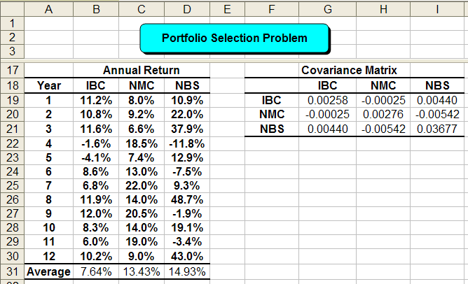
Portfolio Data
Ray used the Average() function to calculate the average return of stocks. He used the COVAR() function in Excel to create the covariance matrix. For example, the covariance matrix indicates that the variances in the annual return for IBC, NMC, and NBS are 0.00258, 0.00276, and 0.03677. The entries of the main diagonal represent covariances between different pairs of stocks. For example, the covariance between IBC and NMC is approximately -0.00025.
variances
Cell Formula Copy to
B31 =AVERAGE(B19:B30) C31:D31
G19 =COVAR(B19:B30,$B$19:$B$30) H19:I19
G20 =COVAR(B19:B30,$C$19:$C$30) H20:I20
G21 =COVAR(B19:B30,$D$19:$D$30) H21:I21

Slide 27
Portfolio Problem Formulation
Decision Variables
x_{i}= portion of total funds invested in investment i,
i=1(IBC), 2(NMC), 3(NBS)
Objective
Professor Dong, Washington University in St. Louis, MO

Slide 28
Portfolio Problem Formulation
Objective
Constraints
Professor Dong, Washington University in St. Louis, MO

Slide 29
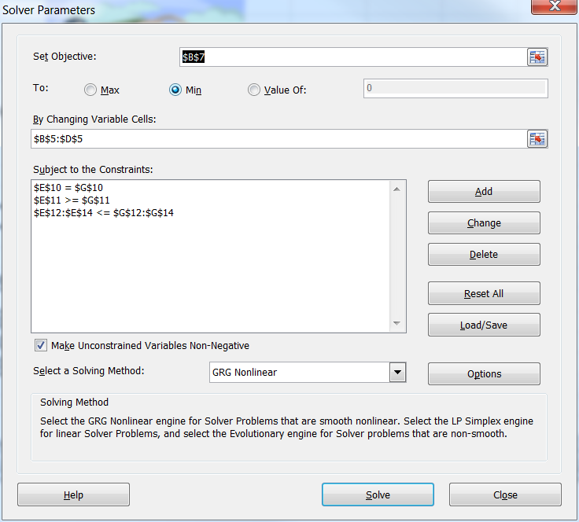
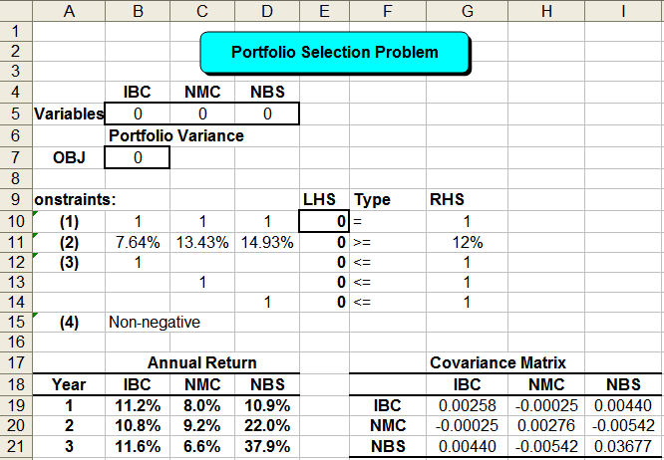
Portfolio Problem Excel Setup
Cell Formula Copy to
B7 =G19*B5^2+H20*C5^2+I21*D5^2+2*(B5*C5*H19+B5*D5*I19+C5*D5*I20)
E10 =SUMPRODUCT(B10:D10,$B$5:$D$5) E11:E14

Slide 30
Summary
Increasing computational difficulty in Nonlinear Programming (NLP)
Solve NLP problems using Solver
NONLINEAR PROGRAMS
More general
Nonlinear programs
General concave
or convex problems
Increasing computational difficulty
Concave or convex
quadratic programs
LINEAR PROGRAMS
Professor Dong, Washington University in St. Louis, MO

